Slide 1
Global Education (GE):
Key debates in Sustainable Development
Prof Vanessa Andreotti

Slide 2
Global Education (GE):
Sustainable Development
Sustainability as continuing rapid economic growth (of post-industrialised countries): technology will sort problems out.
Sustainability as regulated growth with a reduced impact on the environment: recycle, reuse, reduce
Sustainability as economic de-growth and better global distribution: reform, rethink, refuse.
Notes:
I will start with my working definition of global education. The definition that I have been using since 2007 was developed by a group of educators at the Global Education Network conference in Nuremberg in 2007Global Education is located in the intersection of four dimensions: self and other, the other in her context and the self in his context. These intersections consist of socially and historically located perceptions and relationships grounded in different ways of being, knowing and seeing. These three intersections are nested within a historical process that is deeply affecting its dynamics: globalisation.
2

Slide 3
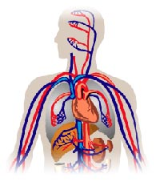
Global Education:
Sustainable Development
SYSTEMS: MACRO-MICRO IDEA
MACRO
MICRO
The macro contains the micro.
The macro puts limits to /determines the micro.
Notes:
3

Slide 4
Global Education:
Sustainable Development
IDEAL SYSTEM
NATURAL SYSTEM (LIFE AND RESOURCES)
SOCIAL-CULTURAL SYSTEM (VALUES, BEHAVIOURS AND RELATIONSHIPS)
EDUCATIONAL SYSTEM
ECONOMIC SYSTEM
WHAT DETERMINES WHAT?
Notes:
4

Slide 5
Global Education:
Sustainable Development
WHAT SHOULD DETERMINE WHAT IN AN IDEAL SYSTEM?
What makes an ‘ideal’ system?
When are individuals happy? Why do they work or study?
Who defines what a good life or a good society is?
Does everyone think in the same way?
What/who shapes what individuals want/wish for?
What happens to people who disagree with the majority?
To what extend people have the right to determine what they want for themselves?
Does society change? How?
What is the role of education?
Notes:
5

Slide 6
Global Education:
Sustainable Development
WHAT DETERMINES WHAT IN THE REAL SYSTEM?
NATURAL SYSTEM (LIFE AND RESOURCES)
SOCIAL-CULTURAL SYSTEM (VALUES, BEHAVIOURS AND RELATIONSHIPS)
EDUCATIONAL SYSTEM
ECONOMIC SYSTEM
WHAT IS/SHOULD BE THE ROLE OF EDUCATION?
Notes:
6

Slide 7
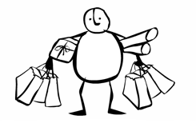
Global Education:
Sustainable Development
STORY OF STUFF: http://www.storyofstuff.com/
Notes:
7

Slide 8
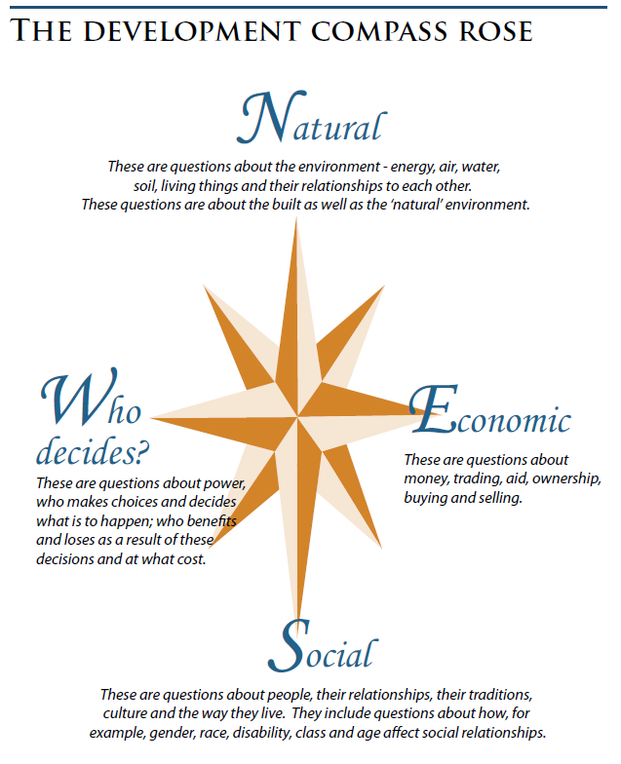
Global Education (GE):
Development compass rose
Notes:
I will start with my working definition of global education. The definition that I have been using since 2007 was developed by a group of educators at the Global Education Network conference in Nuremberg in 2007Global Education is located in the intersection of four dimensions: self and other, the other in her context and the self in his context. These intersections consist of socially and historically located perceptions and relationships grounded in different ways of being, knowing and seeing. These three intersections are nested within a historical process that is deeply affecting its dynamics: globalisation.
8

Slide 9
Global Education:
Sustainable Development
The importance of seeing things through other eyes:
Watch the you tube animation ‘Abuela Grillo’ about the uprising of the people of Cochabamba in Bolivia against water privatization. The animation is based on a Ayoreo (indigenous) narrative about a cricket grandmother whose singing produces water. The grandmother can be seen as a metaphor for the metaphysical forces/spirits behind natural phenomena (represented, in this case, in human form). As you watch the film, think about: how does the grandmother establish her relations? What happens when the
grandmother starts to be exploited? How would the story of the uprising be different if told from a Western perspective? What can we learn about sustainable development from the story?
http://www.youtube.com/watch?v=YMM7vM7aiNI
Notes:
9

